Slide 1

Machine Vision CHC6781
Lecture 8:
Classical CNN Architectures
Module Leader: Dr Happy N. Monday
Contact via:
Email: happy.monday@zy.cdut.edu.cn
Office: Room 8102

Slide 2

Class Rules
Be on time
Bring your stuff (Pen, papers, folder, brain)
No pressing of phone, or gaming in the class.
Habit of Effective learners.
Prepare for your coursework and exam on time.
Always revise your PPTs before and after class.
Have Fun

Slide 3
Learning Outcomes
Students will understand how to choose the right CNN model for different tasks and comprehend the evolution of deep learning
Students will understand the influence of early CNN design (LeNet-5) on deep learning advancement.
Understand how ImageNet highlights the significance of datasets in deep learning research and evaluation.
Understanding ZFNet will help the students gain knowledge how minor adjustments to architecture can significantly impact CNN performance.
Understand how ResNet's residual connections and inception driven-architectures can address deep network challenges and achieve computational efficiency..

Slide 4
References
1. Richard Szeliski. (2017). Computer Vision: Algorithms and Applications. Springer
2. Géron, A. (2019). Hands-On Machine Learning with Scikit-Learn, Keras, and TensorFlow. O'Reilly Media.
3. Aggarwal, C.C. (2018). Neural Networks and Deep Learning. Springer
4. Goodfellow, I., Bengio, Y., & Courville, A. (2016). Deep Learning. MIT Press.
5. Hastie, T., Tibshirani, R., & Friedman, J. (2009). The Elements of Statistical Learning: Data Mining, Inference, and Prediction. Springer.
Gulli, A, Pal, S. (2017). Deep Learning with Keras. Packt Publishing
Montavon, G. Orr, G. Muller, K.K. (2012). Neural Networks: Tricks of the Trade. Springer.

Slide 5
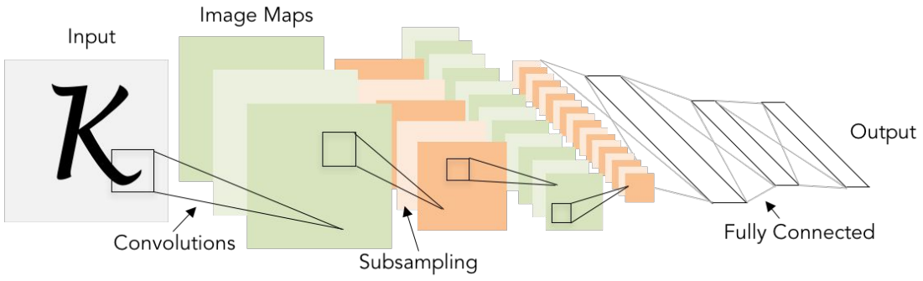
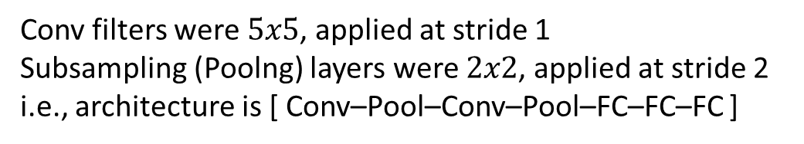
Review: LeNet-5
[LeCun, Bottou, Bengio, Haffner, 1998]
Conv filters were $5x5$, applied at stride 1
Subsampling (Poolng) layers were $2x2$, applied at stride 2
i.e., architecture is [ Conv–Pool–Conv–Pool–FC–FC–FC ]

Slide 6
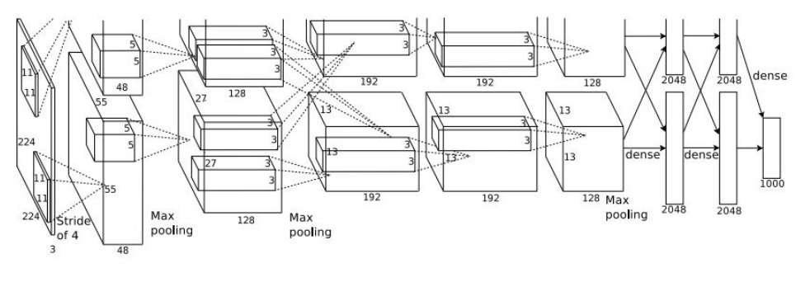
Case Study: AlexNet
[ Krizhevsky et al. 2012]
Architecture:
Conv1
MaxPool1
Norm1
Conv2
MaxPool2
Norm2
Conv3
Conv4
Conv5
FC6
FC7
FC8

Slide 7
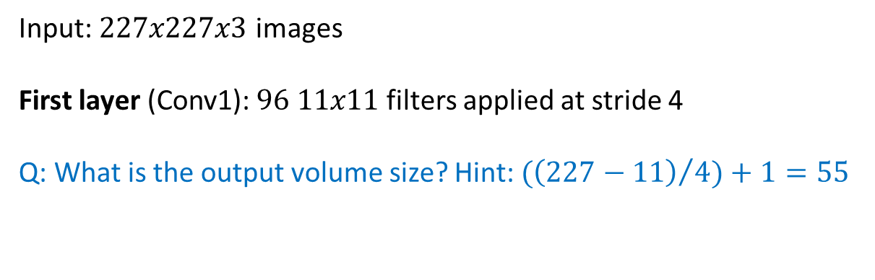
Case Study: AlexNet
[ Krizhevsky et al. 2012]
Input: $227x227x3$ images
First layer (Conv1): $96 11x11$ filters applied at stride 4
Q: What is the output volume size? Hint: ${(\left(227−11\right)}/{4)+1}=55$

Slide 8
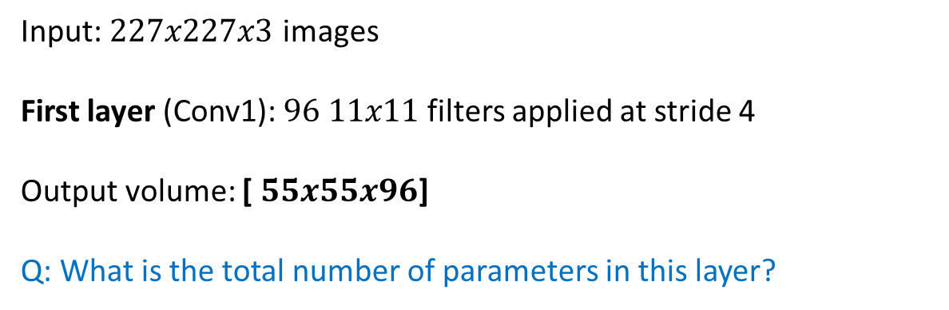
Case Study: AlexNet
[ Krizhevsky et al. 2012]
Input: $227x227x3$ images
First layer (Conv1): $96 11x11$ filters applied at stride 4
Output volume: [ $55x55x96$]
Q: What is the total number of parameters in this layer?

Slide 9
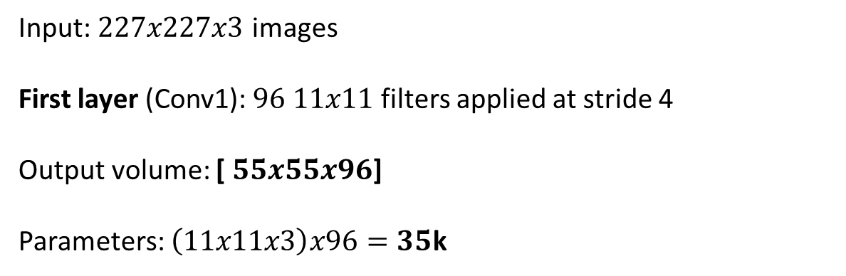
Case Study: AlexNet
[ Krizhevsky et al. 2012]
Input: $227x227x3$ images
First layer (Conv1): $96 11x11$ filters applied at stride 4
Output volume: [ $55x55x96$]
Parameters: $\left(11x11x3\right)x96=35$k

Slide 10
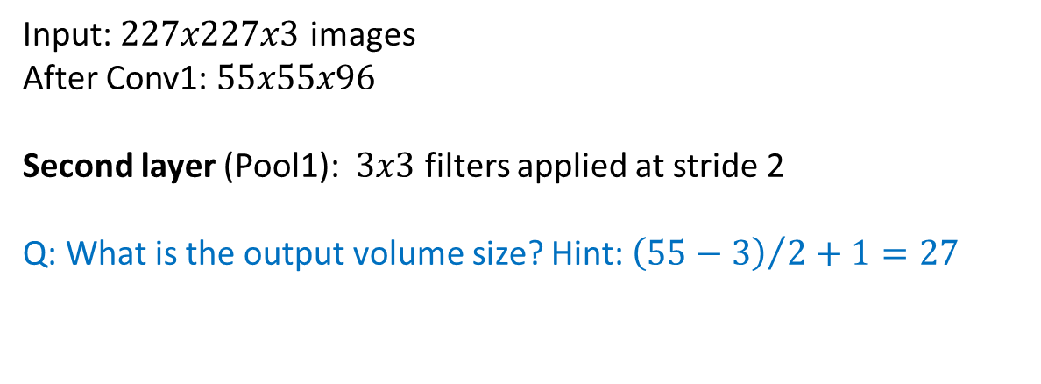
Case Study: AlexNet
[ Krizhevsky et al. 2012]
Input: $227x227x3$ images
After Conv1: $55x55x96$
Second layer (Pool1): $3x3$ filters applied at stride 2
Q: What is the output volume size? Hint: ${\left(55−3\right)}/{2+1}=27$

Slide 11
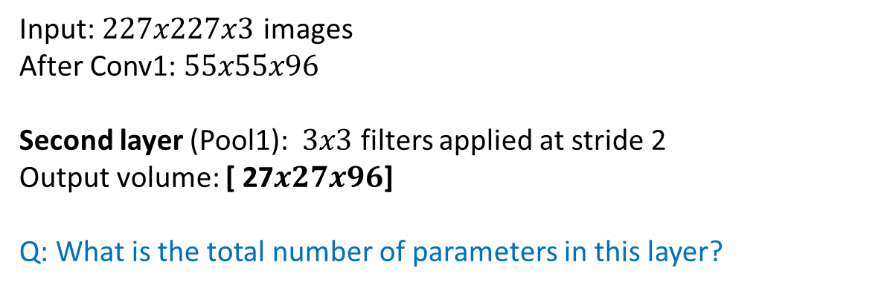
Case Study: AlexNet
[ Krizhevsky et al. 2012]
Input: $227x227x3$ images
After Conv1: $55x55x96$
Second layer (Pool1): $3x3$ filters applied at stride 2
Output volume: [ 27$x27x96$]
Q: What is the total number of parameters in this layer?

Slide 12
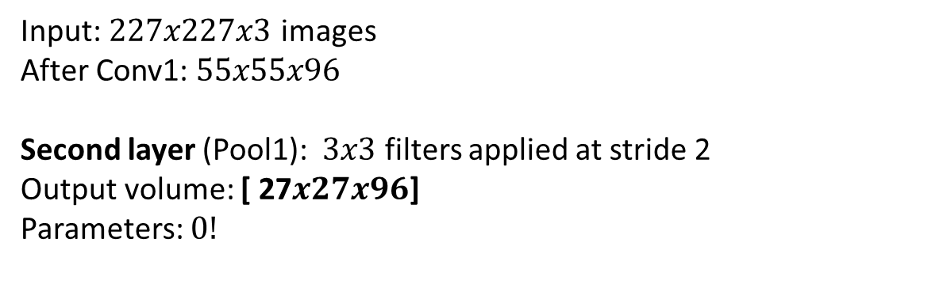
Case Study: AlexNet
[ Krizhevsky et al. 2012]
Input: $227x227x3$ images
After Conv1: $55x55x96$
Second layer (Pool1): $3x3$ filters applied at stride 2
Output volume: [ 27$x27x96$]
Parameters: $0!$

Slide 13
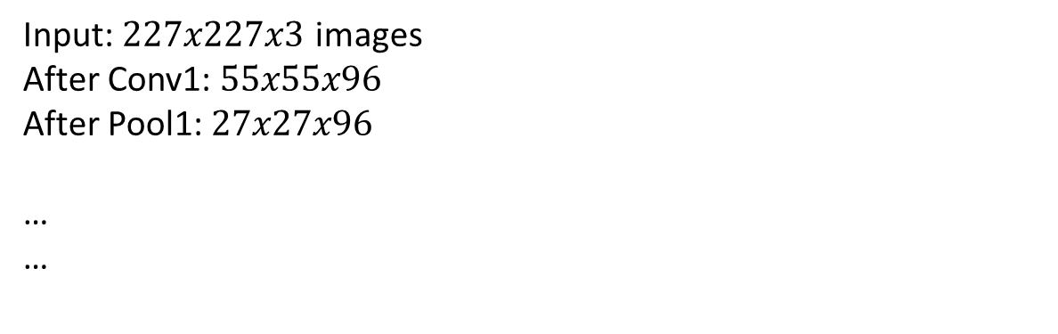
Case Study: AlexNet
[ Krizhevsky et al. 2012]
Input: $227x227x3$ images
After Conv1: $55x55x96$
After Pool1: $27x27x96$
…
…

Slide 14
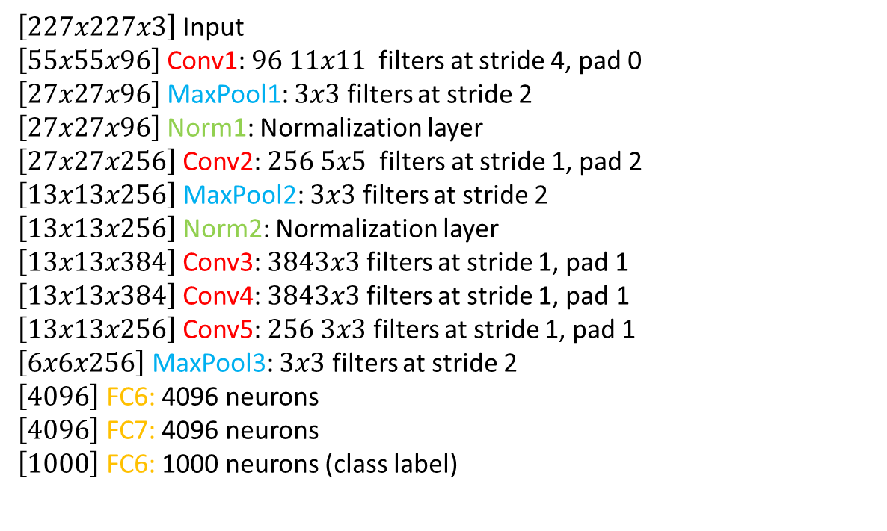
Case Study: AlexNet
Full ( simplified ) AlexNet Architecture:
$\left[227x227x3\right]$ Input
$\left[55x55x96\right]$ Conv1: $96 11x11$ filters at stride 4, pad 0
$\left[27x27x96\right]$ MaxPool1: $3x3$ filters at stride 2
$\left[27x27x96\right]$ Norm1: Normalization layer
$\left[27x27x256\right]$ Conv2: $256 5x5$ filters at stride 1, pad 2
$\left[13x13x256\right]$ MaxPool2: $3x3$ filters at stride 2
$\left[13x13x256\right]$ Norm2: Normalization layer
$\left[13x13x384\right]$ Conv3: $3843x3$ filters at stride 1, pad 1
$\left[13x13x384\right]$ Conv4: $3843x3$filters at stride 1, pad 1
$\left[13x13x256\right]$ Conv5: $256 3x3$ filters at stride 1, pad 1
$\left[6x6x256\right]$ MaxPool3: $3x3$ filters at stride 2
$\left[4096\right]$ FC6: 4096 neurons
$\left[4096\right]$ FC7: 4096 neurons
$\left[1000\right]$ FC6: 1000 neurons (class label)
[ Krizhevsky et al. 2012]

Slide 15
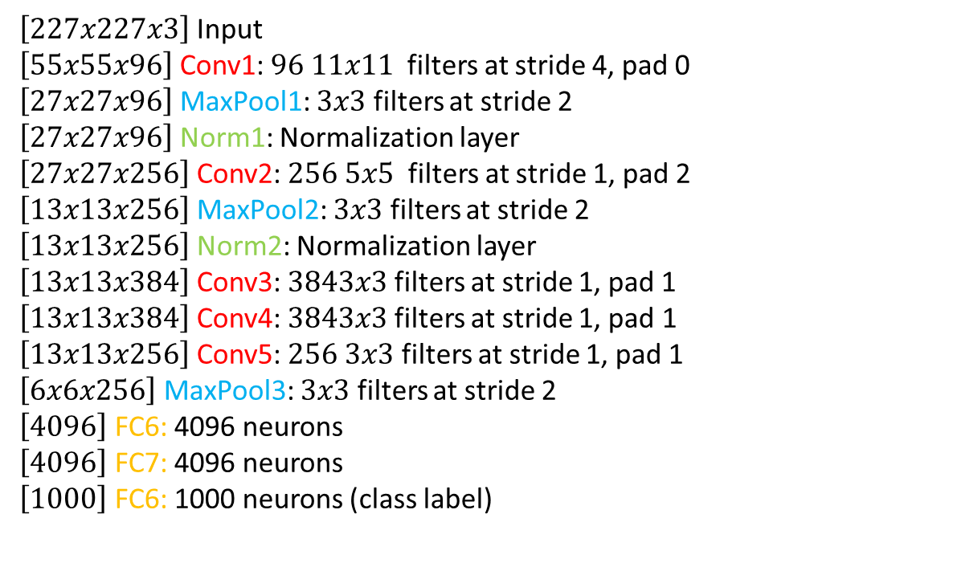
Case Study: AlexNet
Full ( simplified ) AlexNet architecture:
$\left[227x227x3\right]$ Input
$\left[55x55x96\right]$ Conv1: $96 11x11$ filters at stride 4, pad 0
$\left[27x27x96\right]$ MaxPool1: $3x3$ filters at stride 2
$\left[27x27x96\right]$ Norm1: Normalization layer
$\left[27x27x256\right]$ Conv2: $256 5x5$ filters at stride 1, pad 2
$\left[13x13x256\right]$ MaxPool2: $3x3$ filters at stride 2
$\left[13x13x256\right]$ Norm2: Normalization layer
$\left[13x13x384\right]$ Conv3: $3843x3$ filters at stride 1, pad 1
$\left[13x13x384\right]$ Conv4: $3843x3$filters at stride 1, pad 1
$\left[13x13x256\right]$ Conv5: $256 3x3$ filters at stride 1, pad 1
$\left[6x6x256\right]$ MaxPool3: $3x3$ filters at stride 2
$\left[4096\right]$ FC6: 4096 neurons
$\left[4096\right]$ FC7: 4096 neurons
$\left[1000\right]$ FC6: 1000 neurons (class label)
[ Krizhevsky et al. 2012]
Details/Retrospectives:
First use of ReLU
Used norm layers (not in use anymore)
Heavy data augmentation
Dropout 0.5
Batch size 128
SGD momentum 0.9
Learning rate 1e-2
L2 weight decay 5e-4
8 CNN layers

Slide 16
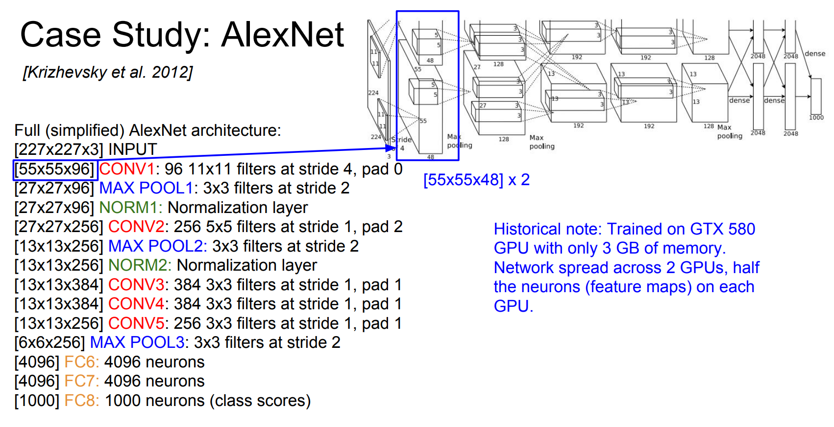

Slide 17
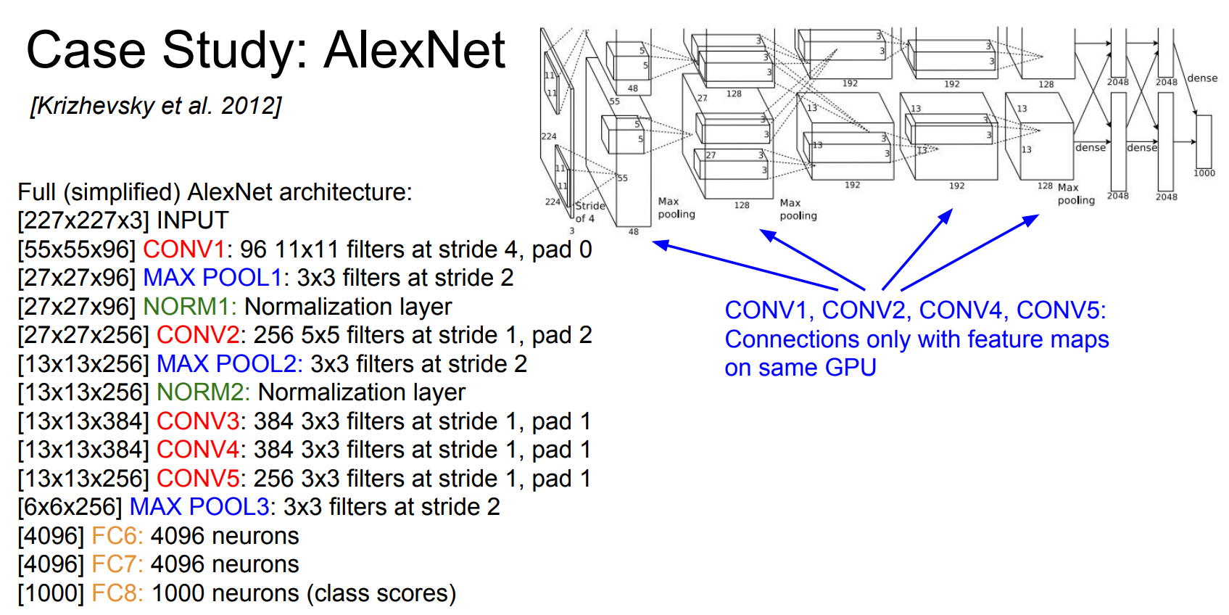

Slide 18
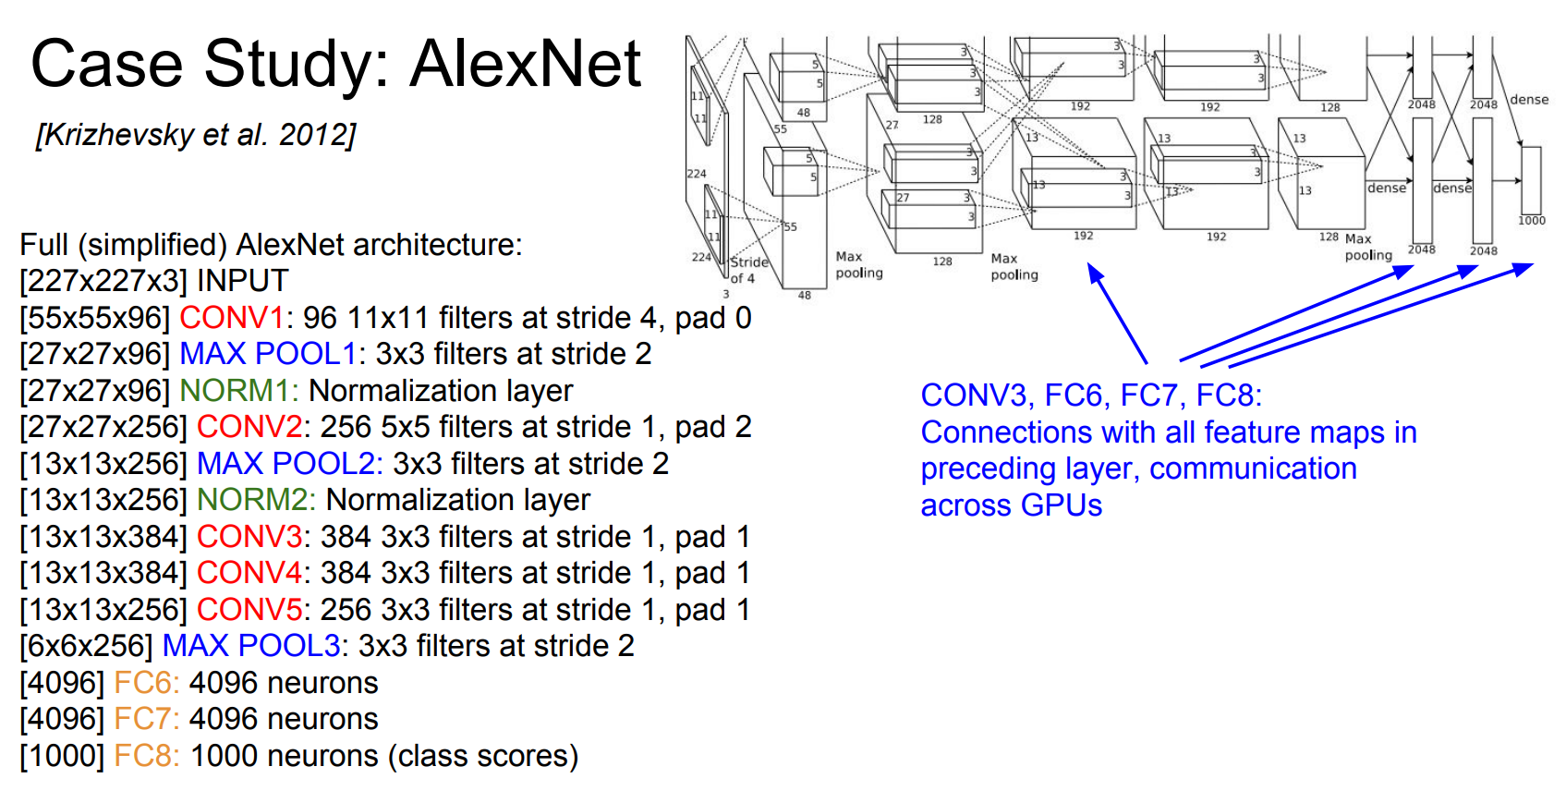

Slide 19
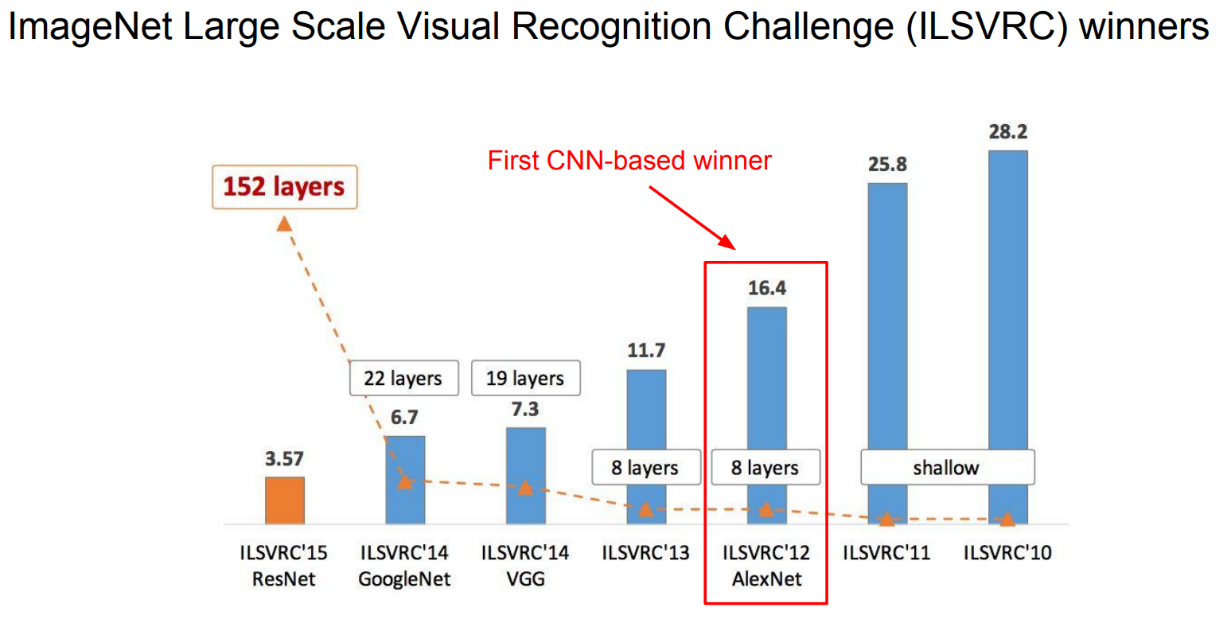

Slide 20
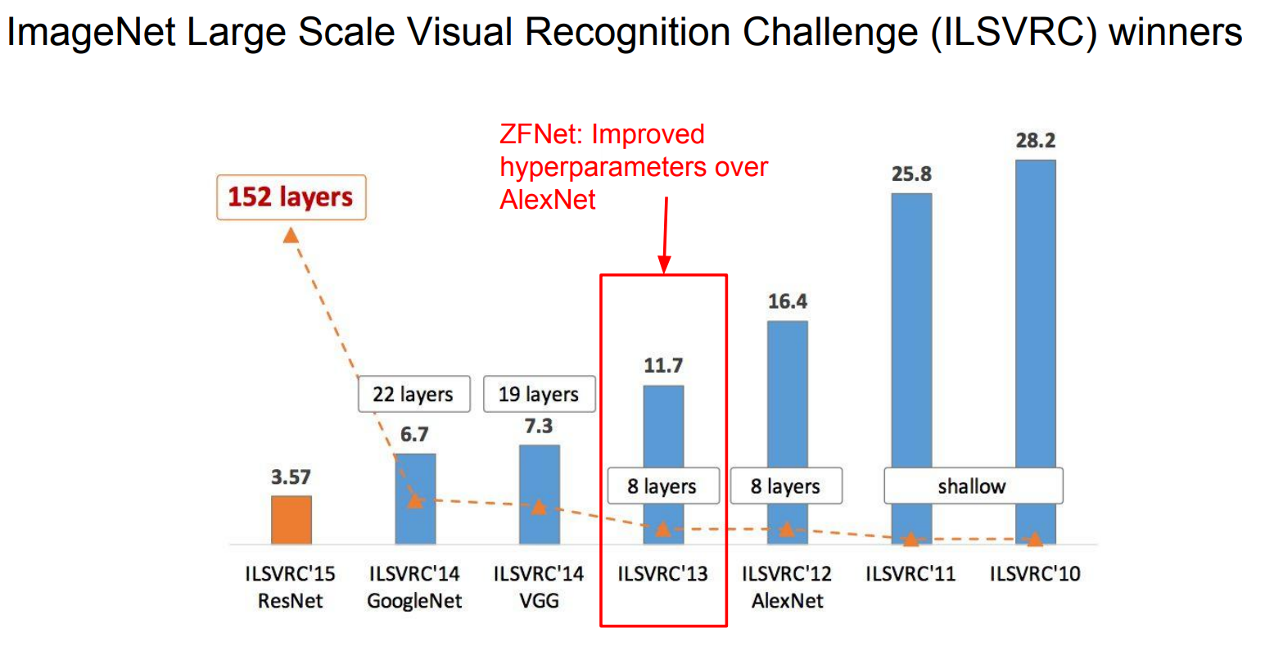

Slide 21
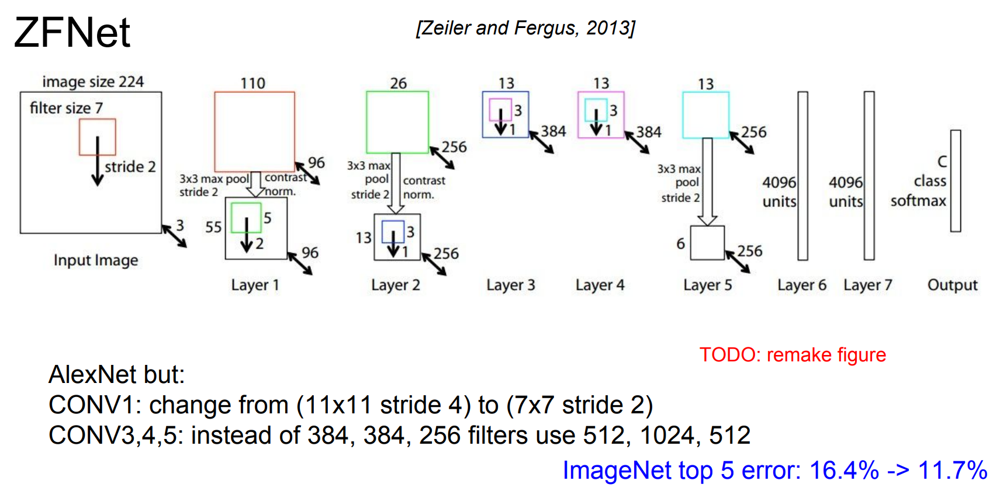

Slide 22
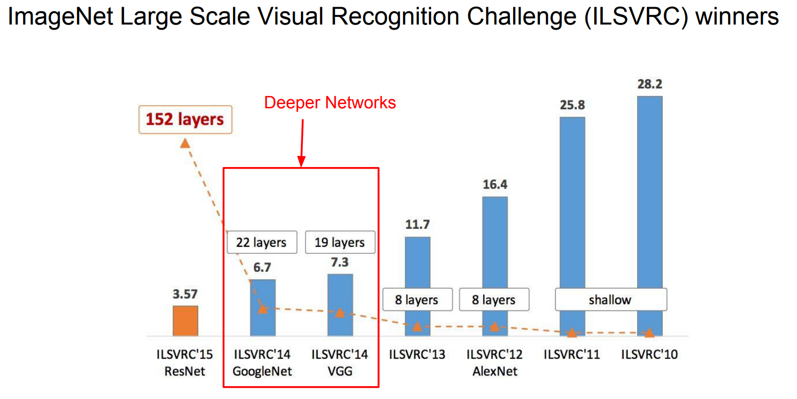

Slide 23
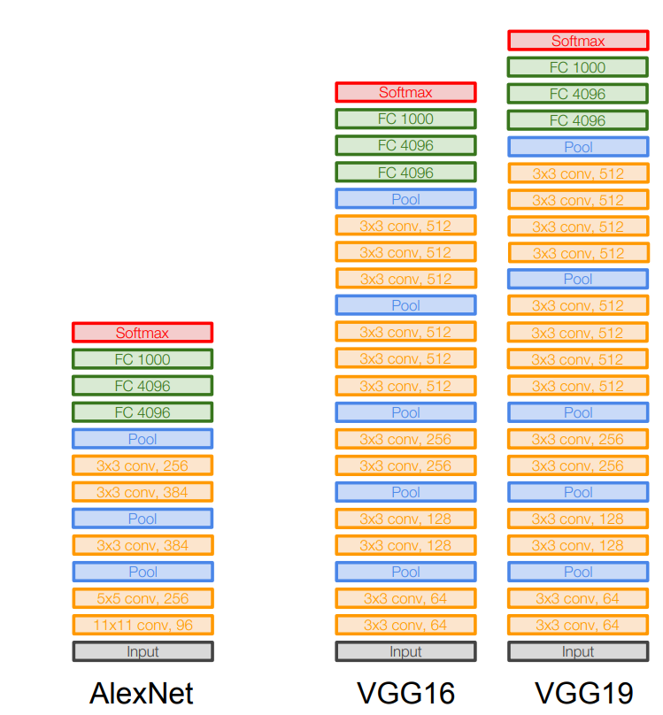
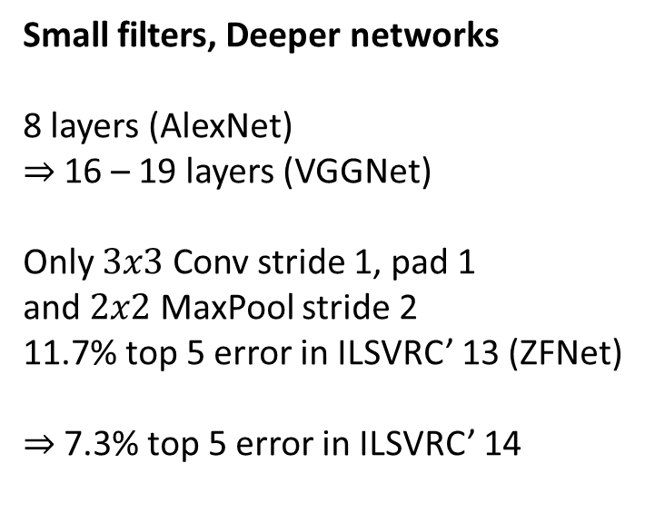
Case Study: VGGNet
[ Simonyan and Zisserman 2014]
Small filters, Deeper networks
8 layers (AlexNet)
$⇒$ 16 – 19 layers (VGGNet)
Only $3x3$ Conv stride 1, pad 1
and $2x2$ MaxPool stride 2
11.7% top 5 error in ILSVRC’ 13 (ZFNet)
$⇒$ 7.3% top 5 error in ILSVRC’ 14

Slide 24
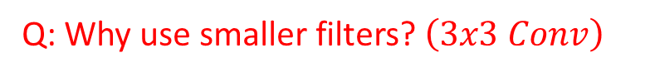
Case Study: VGGNet
[ Simonyan and Zisserman 2014]
Q: Why use smaller filters? $\left(3x3 Conv\right)$

Slide 25
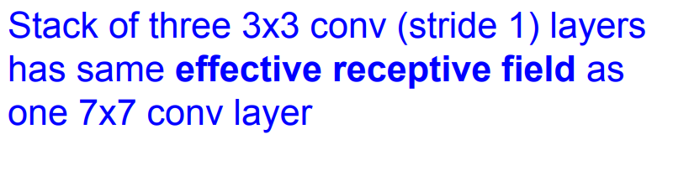

Case Study: VGGNet
[ Simonyan and Zisserman 2014]
Q: Why use smaller filters? $\left(3x3 Conv\right)$

Slide 26
Case Study: VGGNet
[ Simonyan and Zisserman 2014]
Q: Why use smaller filters? $\left(3x3 Conv\right)$
Stacking multiple layers of small filters increases the overall non-linear activation of the network. For example, three consecutive 3x3 convolutions have a receptive field equivalent to a single 7x7 convolution but with a deeper non-linearity. This allows the network to learn more complex features.

Slide 27
Case Study: VGGNet
[ Simonyan and Zisserman 2014]
Q: Why use smaller filters? $\left(3x3 Conv\right)$
Stacking multiple layers of small filters allows the network to learn hierarchical features. The early layers can capture low-level features (e.g., edges, textures), and as we move deeper into the network, the filters can learn more complex and abstract features.
Smaller filters typically require less memory than larger filters, making it more feasible to train and deploy deep networks on devices with limited resources, such as mobile phones or edge devices.

Slide 28
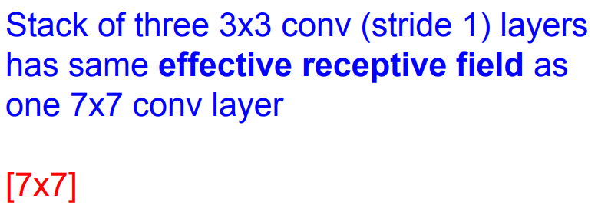
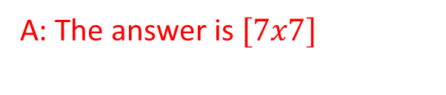
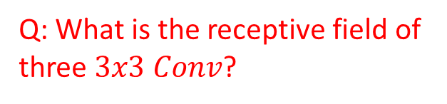
Case Study: VGGNet
[ Simonyan and Zisserman 2014]
Q: What is the receptive field of three $3x3 Conv$?
A: The answer is $[7x7]$

Slide 29
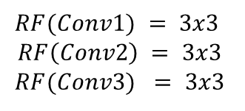
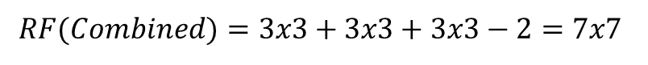
Case Study: VGGNet
The receptive field of Conv2 is not just in terms of the original input x but also includes the receptive field of Conv1, and also applies to Conv3
[ Simonyan and Zisserman 2014]
Q: What is the receptive field of three $3x3 Conv$?
$$RF\left(Combined\right)=RF\left(Conv1\right)+RF\left(Conv2\right)+RF(Conv3)−2$$
$$RF(Conv1) = 3x3$$
$$RF\left(Conv2\right) = 3x3$$
$$RF(Conv3) = 3x3$$
$$RF(Combined)=3x3+3x3+3x3−2=7x7$$
The "- 2" term accounts for the overlap between the receptive fields.

Slide 30
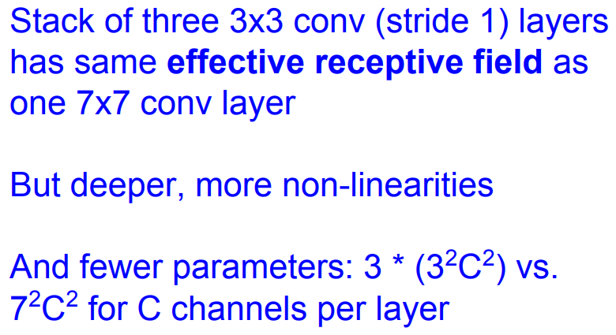
Case Study: VGGNet
[ Simonyan and Zisserman 2014]
Q: Why use smaller filters? $\left(3x3 Conv\right)$
The increased non-linearity comes from having more activation functions applied across the three layers, allowing the network to learn more complex and non-linear mappings from the input to the output.

Slide 31
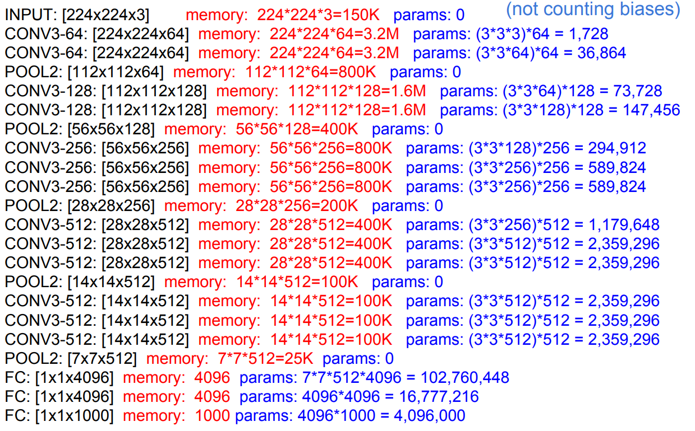

Slide 32
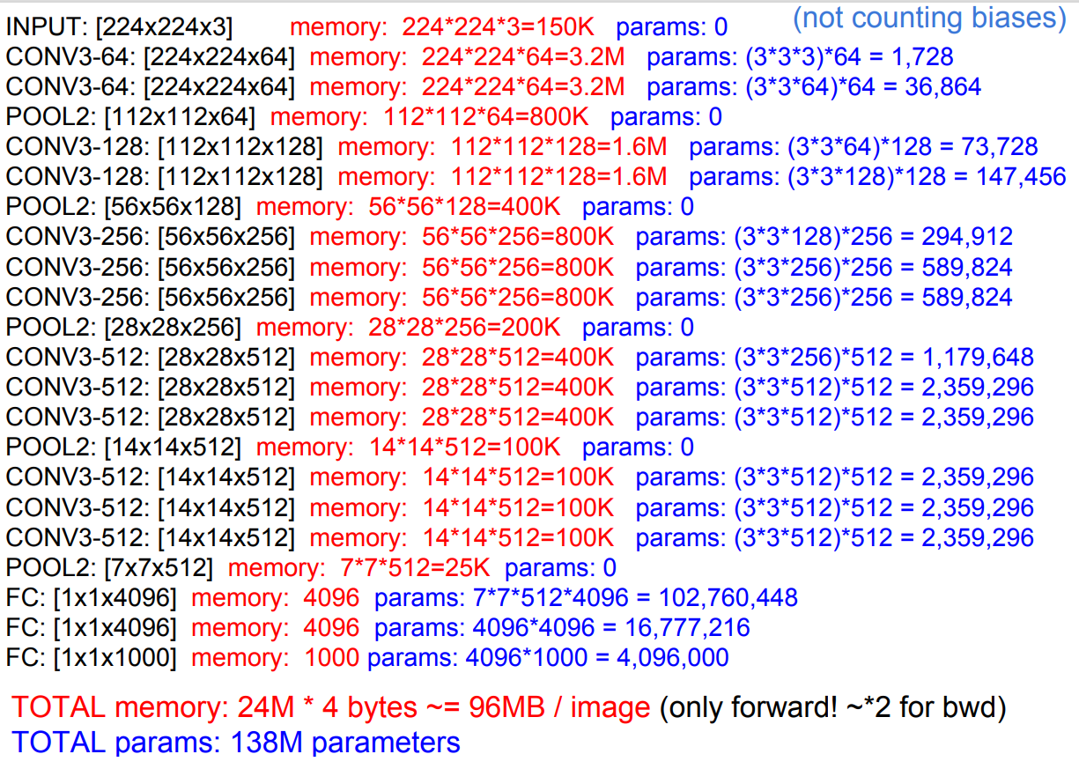

Slide 33
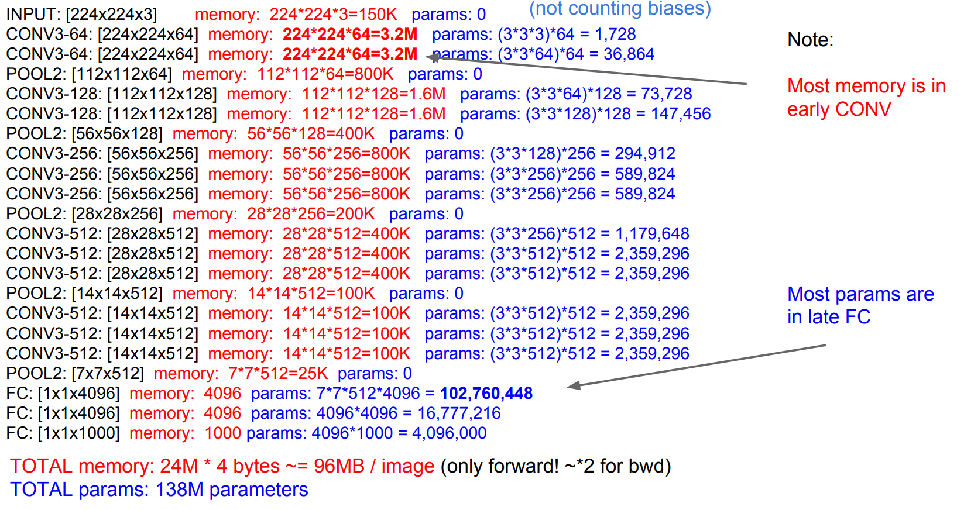

Slide 34
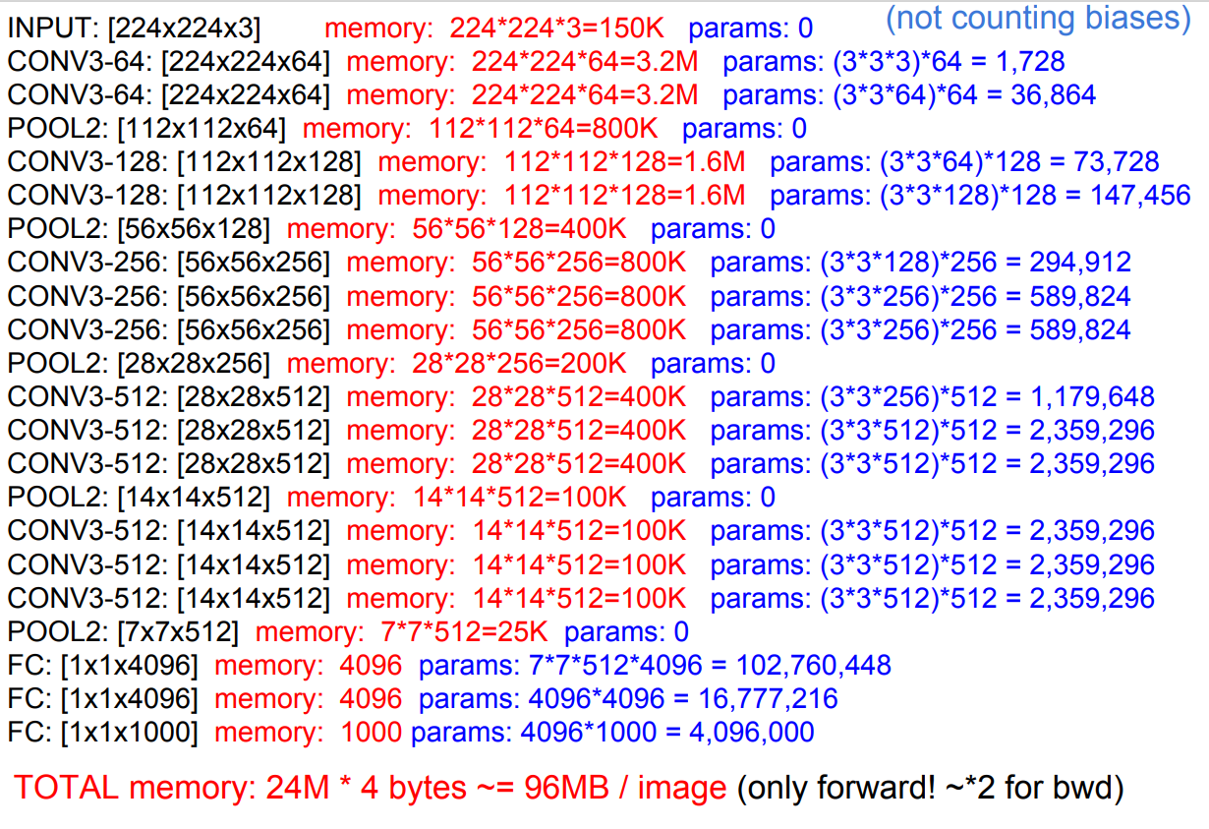
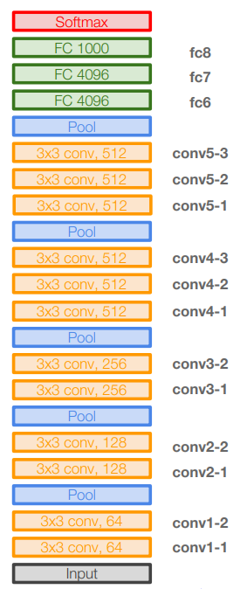
Common names

Slide 35
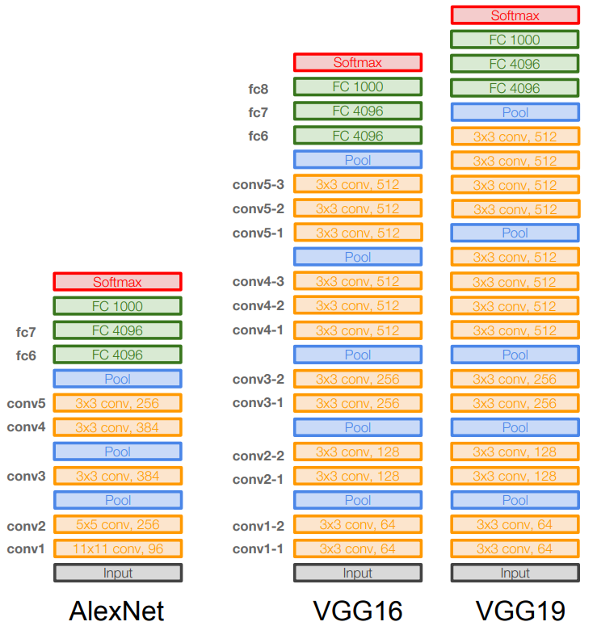
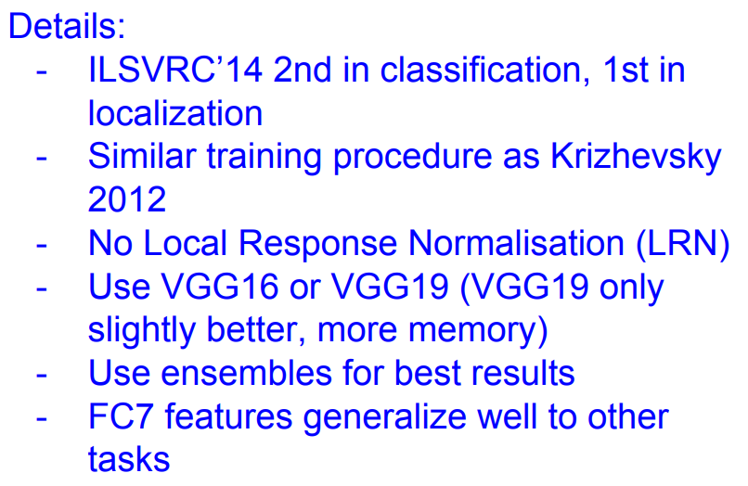
Case Study: VGGNet
[ Simonyan and Zisserman 2014]

Slide 36
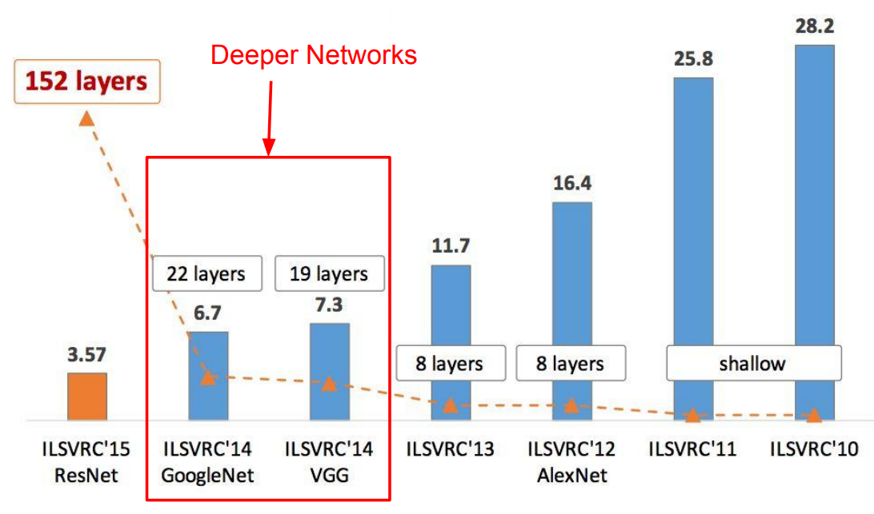
ImageNet Large Scale Visual Recognition Challenge (ILSVRC) winners

Slide 37
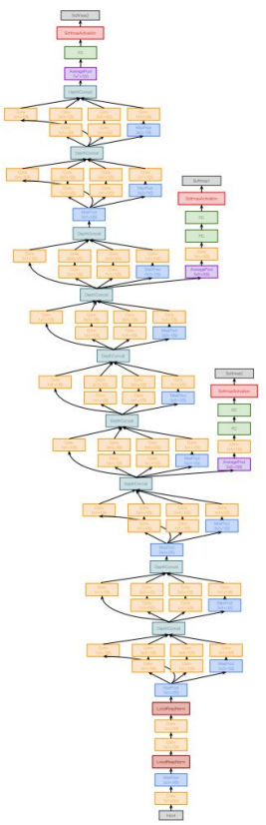
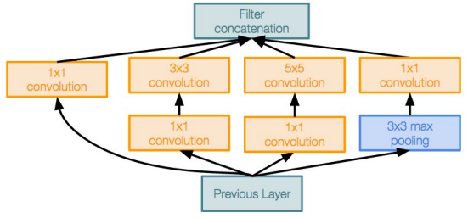
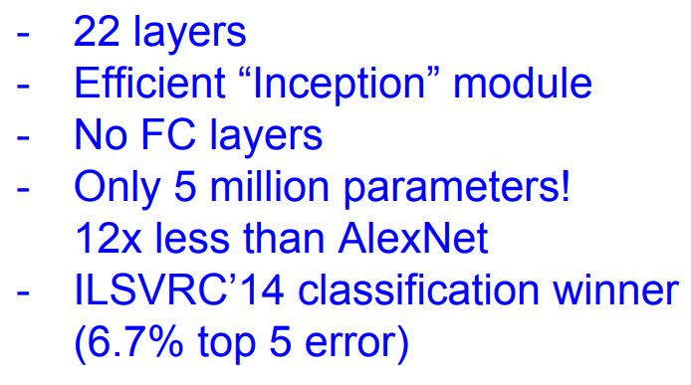
Case Study: GoogleNet
[Szegedy et al.,2014]
Deeper networks, with computational efficiency
Inception module

Slide 38
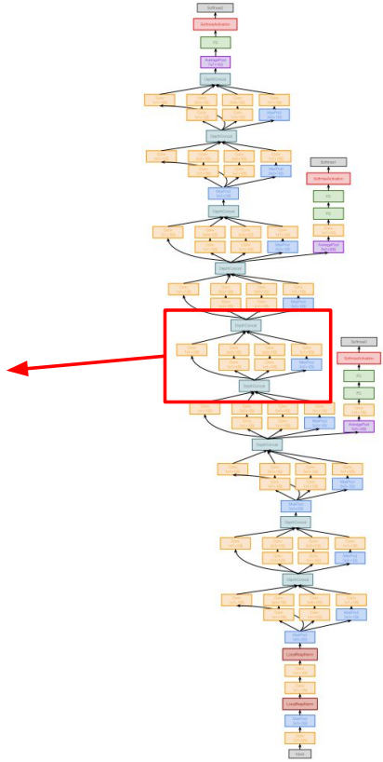
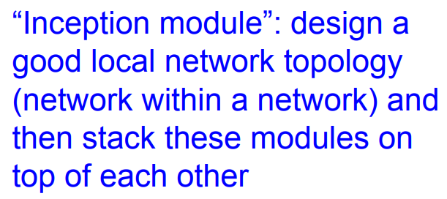
Case Study: GoogleNet
[Szegedy et al.,2014]
Inception module

Slide 39
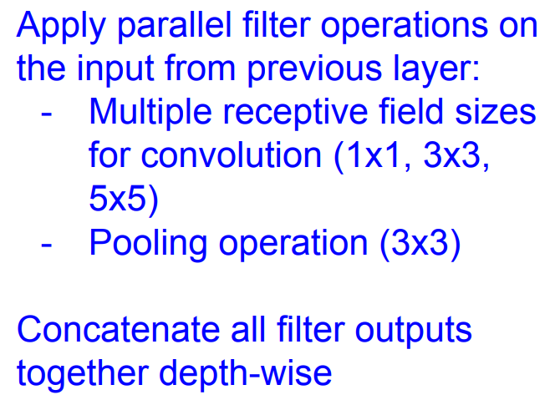
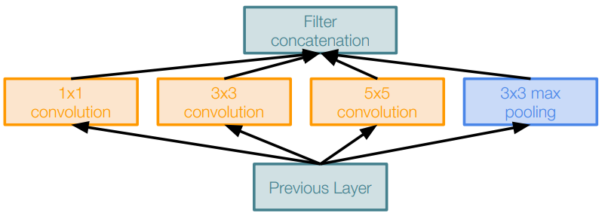
Case Study: GoogleNet
[Szegedy et al.,2014]
Naïve Inception module

Slide 40
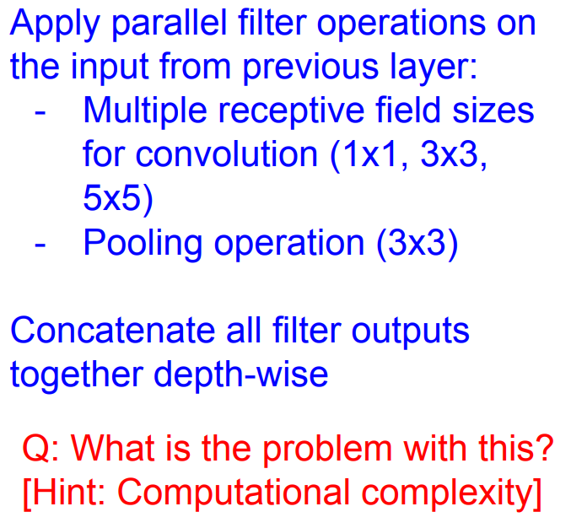
Case Study: GoogleNet
[Szegedy et al.,2014]
Naïve Inception module

Slide 41
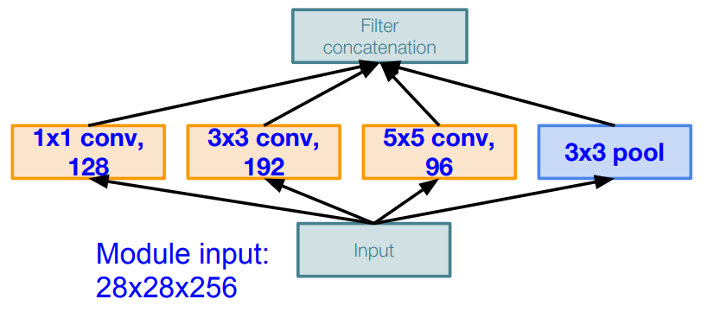
Case Study: GoogleNet
Q: What is the problem with this? [Hint: Computational complexity]
[Szegedy et al.,2014]
Example:
Naïve Inception module

Slide 42
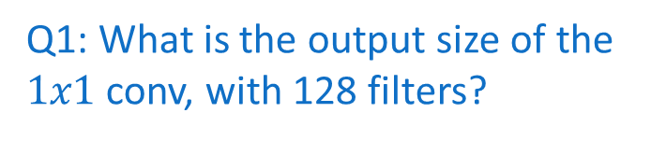
Case Study: GoogleNet
Q: What is the problem with this? [Hint: Computational complexity]
[Szegedy et al.,2014]
Example:
Q1: What is the output size of the $1x1$ conv, with 128 filters?
Naïve Inception module

Slide 43
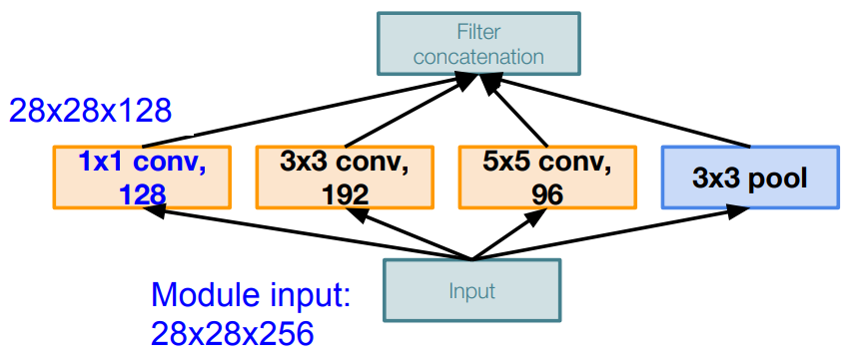
Case Study: GoogleNet
Q: What is the problem with this? [Hint: Computational complexity]
[Szegedy et al.,2014]
Example:
Q1: What is the output size of the $1x1$ conv, with 128 filters?
Naïve Inception module

Slide 44
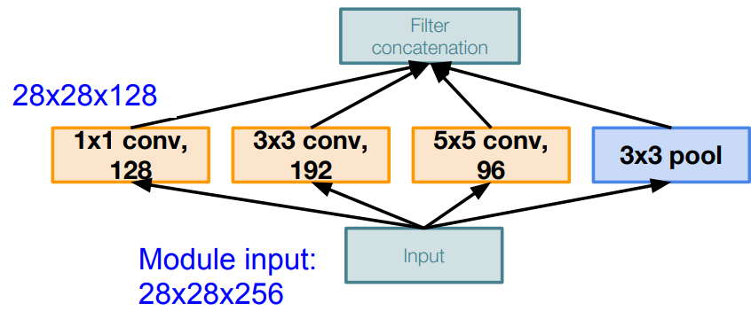
Case Study: GoogleNet
Q: What is the problem with this? [Hint: Computational complexity]
[Szegedy et al.,2014]
Example:
Q2: What is the output sizes of all different filter operations?
Naïve Inception module

Slide 45
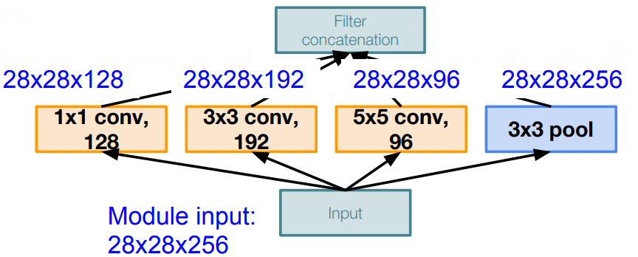
Case Study: GoogleNet
Q: What is the problem with this? [Hint: Computational complexity]
[Szegedy et al.,2014]
Example:
Q2: What is the output sizes of all different filter operations?
Naïve Inception module

Slide 46

Case Study: GoogleNet
Q: What is the problem with this? [Hint: Computational complexity]
[Szegedy et al.,2014]
Example:
Q2: What is the output size after filter concatenation?
Naïve Inception module

Slide 47

Case Study: GoogleNet
Q: What is the problem with this? [Hint: Computational complexity]
[Szegedy et al.,2014]
Example:
Q2: What is the output size after filter concatenation?
Naïve Inception module

Slide 48

Case Study: GoogleNet
Q: What is the problem with this? [Hint: Computational complexity]
[Szegedy et al.,2014]
Example:
Q2: What is the output size after filter concatenation?
Naïve Inception module

Slide 49

Case Study: GoogleNet
Q: What is the problem with this? [Hint: Computational complexity]
[Szegedy et al.,2014]
Example:
Q2: What is the output size after filter concatenation?
Naïve Inception module

Slide 50


Case Study: GoogleNet
Q: What is the problem with this? [Hint: Computational complexity]
[Szegedy et al.,2014]
Example:
Q2: What is the output size after filter concatenation?
Naïve Inception module

Slide 51





Reminder: $1x1$ Convolutions
$1x1$ Conv
with 32 filter
(each filter has size $1x1x64$, and performs a 64-dimensional dot product)

Slide 52
Reminder: $1x1$ Convolutions
$1x1$ Conv
with 32 filter
Preserves spatial dimension, reduce depth!
Projects depth to lower dimension (combination of feature maps)

Slide 53


Case Study: GoogleNet
[Szegedy et al.,2014]
Naive Inception module
Inception module with dimension reduction

Slide 54

Case Study: GoogleNet
[Szegedy et al.,2014]
$1x1$ conv “bottleneck” layers
Naive Inception module
Inception module with dimension reduction

Slide 55


Case Study: GoogleNet
[Szegedy et al.,2014]
Inception module with dimension reduction

Slide 56
Case Study: GoogleNet
[Szegedy et al.,2014]
Stack inception modules with dimension reduction on top of each other
Inception module

Slide 57


Case Study: GoogleNet
[Szegedy et al.,2014]
Full GoogLeNet architecture
Stem Network: Conv-Pool-
2x Conv-Pool

Slide 58

Case Study: GoogleNet
[Szegedy et al.,2014]
Full GoogLeNet architecture
Stem Inception Modules

Slide 59

Case Study: GoogleNet
[Szegedy et al.,2014]
Full GoogLeNet architecture

Slide 60
Case Study: GoogleNet
[Szegedy et al.,2014]
Full GoogLeNet architecture
Classifier output
(removed expensive FC layers!)

Slide 61

Case Study: GoogleNet
[Szegedy et al.,2014]
Full GoogLeNet architecture
Auxiliary classification outputs to inject additional gradient at lower layers (AvgPool-1x1 Conv-FC-FC-Softmax)

Slide 62
Case Study: GoogleNet
[Szegedy et al.,2014]
Full GoogLeNet architecture

Slide 63

Case Study: GoogleNet
[Szegedy et al.,2014]
Deeper networks, with computational efficiency
Inception module

Slide 64

ImageNet Large Scale Visual Recognition Challenge (ILSVRC) winners

Slide 65



Case Study: ResNet
[He et al.,2015]
Very deep networks using residual connections
Residual block

Slide 66
Case Study: ResNet
[He et al.,2015]
Very deep networks using residual connections
The central idea behind residual learning is to introduce shortcut connections, known as skip connections or identity mappings, that allow the network to learn residual functions. These residual functions represent the difference between the input and output of a particular layer.
Residual block

Slide 67
Case Study: ResNet
[He et al.,2015]
What happens when we continue stacking deeper layers on a “plain” convolutional neural network?

Slide 68


Case Study: ResNet
[He et al.,2015]
What happens when we continue stacking deeper layers on a “plain” convolutional neural network?
Q: What’s strange about these training and test curves?
[Hint: look at the order of the curves]

Slide 69
Case Study: ResNet
[He et al.,2015]
What happens when we continue stacking deeper layers on a “plain” convolutional neural network?
56-layer model performs worse on both training and test error

Slide 70
Case Study: ResNet
[He et al.,2015]
Hypothesis: the problem is an optimization problem. Deeper models are harder to optimize.

Slide 71
Case Study: ResNet
[He et al.,2015]
Hypothesis: the problem is an optimization problem. Deeper models are harder to optimize.
The deeper model should be able to perform at least as well as the shallower model.
A solution by construction is copying the learned layers from the shallower model and setting additional layers to identity mapping.

Slide 72


Case Study: ResNet
[He et al.,2015]
Solution: Use network layers to fit a residual mapping instead of directly trying to fit a desired underlying mapping.
“Plain” layers
Residual block

Slide 73
Case Study: ResNet
[He et al.,2015]
Solution: Use network layers to fit a residual mapping instead of directly trying to fit a desired underlying mapping.
H(x) = F(x) + x
Use layers to fit residual
F(x) = H(x) – x
instead of
H(x) directly
“Plain” layers
Residual block

Slide 74


Case Study: ResNet
[He et al.,2015]
In a regular block (Figure A), the portion within the dotted-line box must directly learn the mapping f(x)
In a residual block (Figure B), the portion within the dotted-line box needs to learn the residual mapping g(x)=f(x)-x
Figure A
Figure B

Slide 75


Case Study: ResNet
[He et al.,2015]
The structure on the left is where we add the input to the output before applying the ReLU nonlinearity whenever use_1x1conv=False
The structure on the right is where we adjust channels and resolution by means of a 1 x 1convolution before adding.

Slide 76


Case Study: ResNet
Homework
1x
1x

Slide 77

Case Study: ResNet
[He et al.,2015]
Residual block

Slide 78


Case Study: ResNet
[He et al.,2015]
Residual block

Slide 79


Case Study: ResNet
[He et al.,2015]
Residual block

Slide 80


Case Study: ResNet
[He et al.,2015]
Residual block

Slide 81
Case Study: ResNet
[He et al.,2015]
Total depths of 34, 50, 101, or 152 layers for ImageNet

Slide 82
Case Study: ResNet
[He et al.,2015]
For deeper networks
(ResNet-50+), use “bottleneck”
Layer to improve efficiency
(similar to GoogLeNet)

Slide 83

Case Study: ResNet
[He et al.,2015]
For deeper networks
(ResNet-50+), use “bottleneck”
Layer to improve efficiency
(similar to GoogLeNet)

Slide 84

Case Study: ResNet
[He et al.,2015]

Slide 85

Case Study: ResNet
[He et al.,2015]

Slide 86

Case Study: ResNet
[He et al.,2015]

Slide 87

ImageNet Large Scale Visual Recognition Challenge (ILSVRC) winners

Slide 88


Slide 89


Slide 90
Attention Mechanism
Learning Outcome:
Understand attention mechanism in computer vision using CNN
Get familiar with building an attention mechanism in CNN

Slide 91


Slide 92

Is there any danger over here?

Slide 93

Is there any danger over here?

Slide 94

Why do we need attention in Computer vision?

Slide 95
Why do we need attention in Computer vision?
To learn important information faster and more focused
Objects or target class that we want to localize and classify

Slide 96


Slide 97
Attention Mechanism
Attention mechanism is a concept inspired by human visual attention.
In the context of neural networks, attention mechanisms have been widely used to improve the performance of various tasks, especially in natural language processing (NLP) and computer vision.

Slide 98
Attention Mechanism
Here's a brief description of how attention works in a neural network context:
1. Context and Query:
- The "context" is the set of input features that the model processes.
- The "query" is a set of features that the model wants to pay attention to.
2. Attention Weights:
- Attention weights are computed to assign importance to different elements in the context based on their relevance to the query.
- The attention weights are often calculated using a similarity function, which measures the similarity between the query and each element in the context.
3. Weighted Sum:
- The context elements are multiplied by their corresponding attention weights and summed up.
- This results in a weighted sum of the context elements, with higher weights given to more relevant elements.
4. Output:
- The weighted sum is used as an input to the subsequent layers of the model or as a direct output, depending on the architecture.

Slide 99
Attention Mechanism
The basic idea behind attention is to selectively focus on certain parts of the input data, giving more weight to the relevant information.
This helps the model to weigh the importance of different elements in the input when making predictions.

Slide 100

Grad-CAM (Gradient-weighted Class Activation Mapping)
Grad-CAM Visualization is one of the ways to critically analyze the results of the attention-based network. Your are expected to use one of the interpretability methods to critically analyze the prediction of your model.

Slide 101

Grad-CAM Cont’d

Slide 102

Grad-CAM Cont’d

Slide 103

SHAP (SHapley Additive exPlanations)
SHAP assigns each feature an importance value for a particular prediction based on cooperative game theory. In image classification, it evaluates the contribution of each pixel or region to the final prediction.

Slide 104

SHAP Cont’d

Slide 105

LIME (Local Interpretable Model-agnostic Explanations)
LIME explains individual predictions by approximating the model locally with an interpretable model. In image classification, it perturbs the input image and observes changes in predictions to identify influential regions.

Slide 106
The End!

